Slide 1
LIPIDS “You are What You Eat”

Slide 2
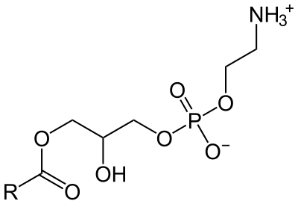
Lipids Chemical Structure
Lipids have no single common structure. The most commonly occurring lipids are triglycerides and phospholipids.
Triglycerides are fats and oils, they have a glycerol backbone bonded to three fatty acids. If the three fatty are similar then the triglyceride is known as simple triglyceride. If the fatty acids are not similar then the fatty acids are known as mixed triglyceride, usually found in foods.
Phospholipids are the second most common class of lipids. They are found in membranes of animal and plants, they contain glycerol and fatty acids, they also contain phosphoric acids and a low-molecular weight alcohol, usually found in membranes. Common phospholipids are lecithins and cephalins.
This image shows a saturated fatty acid chain (contain single carbon bonds) and an unsaturated fatty acid chain (contain double carbon bonds).
This image shows the components and orientation of the hydrophilic phosphate group and the hydrophobic fatty acid chains that form the lipid bi-layer.

Slide 3
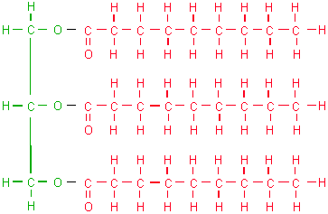
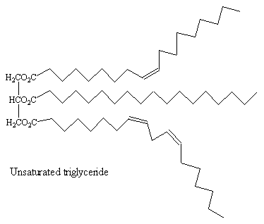
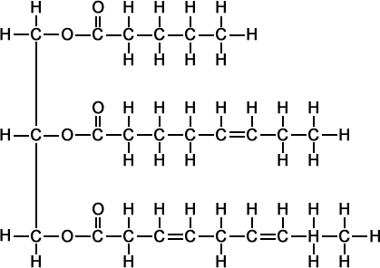
Processes To Synthesize Lipids
Saturated Fats:
- Solid at room temperature
Unsaturated Fats:
- Liquid at room temperature

Slide 4
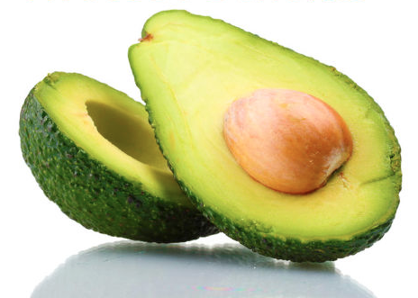
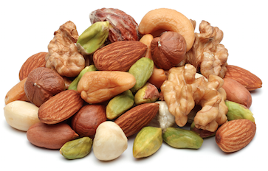
Sources of Lipids
Fatty acids:
Unsaturated fatty acids
Sources of lipids are: oils and nuts:
Oils: vegetable oil, nut oils, and coconut oil.
Nuts: peanuts, almonds, cashews, pistachios, hazelnuts and walnuts.
Other examples: the ones found in beef, poultry, fish, pork, eggs, avocado, cheese, butter, and sour cream.
Unsaturated Fatty Acids:
- Cis
- Trans isomers

Slide 5
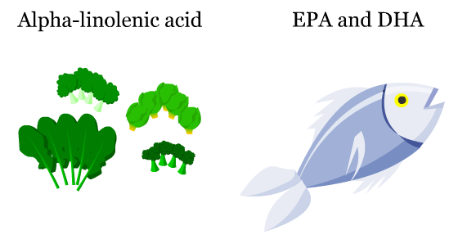
Importance of Fatty Acids
Unsaturated Fatty acids contribute positively to your health, especially polyunsaturated fatty acids.
Alpha-linolenic acids (omega-3) prevents cancer and is essential for our metabolism
Docosahexaenoic acids takes part of 60% of your brain. Lack of DHA can cause deteriorate the capacity of your brain and lead to mental disorders.
Eicosapentaenoic Acids are essential to lower inflammation. It treats schizophrenia and depression.

Slide 6
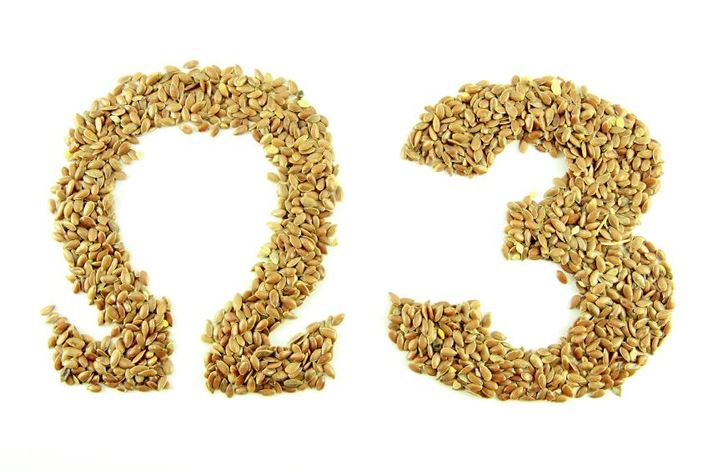
Consequences of Fat Deficiency
- Malnutrition
Mental Illness:
-People with a low intake of Omega-3 Fatty Acids are found to suffer from dyslexia, autism, depression, learning disability, and even schizophrenia
-A low intake of DHA during aging can produce Alzheimer Disease.
Cardiovascular Diseases:
-Low levels of Omega-3 Fatty Acids can cause coronary heart disease, hypertension, stroke, cardiac arrest, arthritis, Crohn’s disease, and multiple sclerosis.
Cancers:
-Studies have found that high intakes of DHA and EPA lower the risk of breast, colon, and prostate cancer.

Slide 7
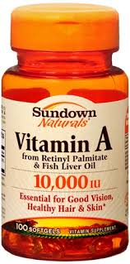
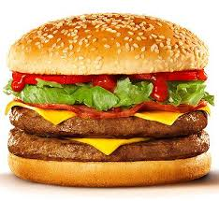
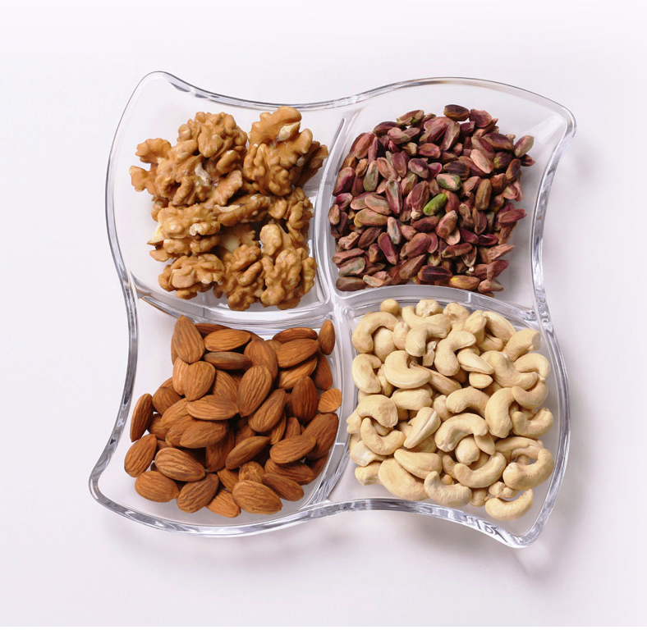
How To Prevent Deficiency Syndrome
We need the fats in our body, one easy step would be eating fats like unsaturated fats, because they are better for the body.
Another way to prevent the deficiency syndrome would be taking vitamins like Vitamin A.
Once in a while you can eat saturated fats even though they are harder to burn off.

Slide 8
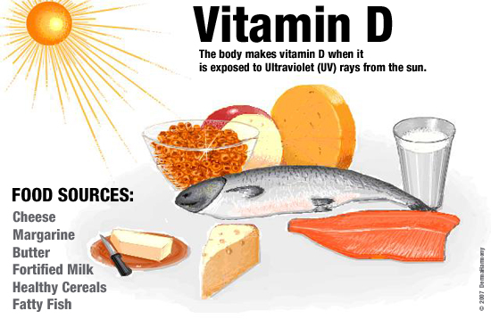
Interesting Facts
The lipid stores as much chemical energy as a carbohydrate.
Lipids are one of the major issue to the human health.
Vitamins like K, E, D and A would be dissolved and stored by using fats.

Slide 9
THE END

