Slide 1
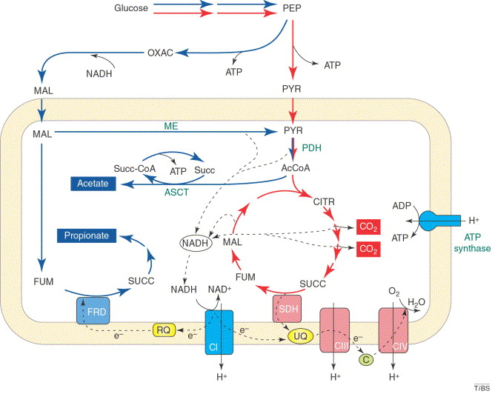
HL 8.1 Metabolism

Slide 2
Metabolism
Metabolic pathways consist of chains and cycles of enzyme-catalyzed reactions.
Notes:
http://www.genome.jp/kegg/

Slide 3
Activation Energy

Slide 4
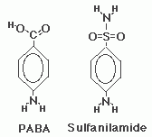
Competitive Inhibition
Substrate and inhibitor are chemically very similar
Inhibitor binds to the active site of the enzyme, prevents substrate from binding
Example: Folic acid synthetase
Folic acid synthetase is an enzyme in bacteria which normally produces folic acid (vitamin) from PABA
Sulfanilamides (antibiotics) occupies the active site of folic acid synthetase; blocks access of PABA
Bacteria die without folic acid

Slide 5
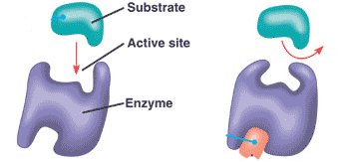
Non-competitive inhibition
Substrate and inhibitor are not similar
Inhibitor binds to the enzyme at different site than the active site
The inhibitor changes the of the enzyme, causing slow enzyme activity
Example: silver, Ag+
silver forms bonds with the -SH groups of cysteine, the amino acid which forms covalent disulfide bridges
the disruption of disulfide bridges alters the tertiary structure of the enzyme, affecting its active site

Slide 6
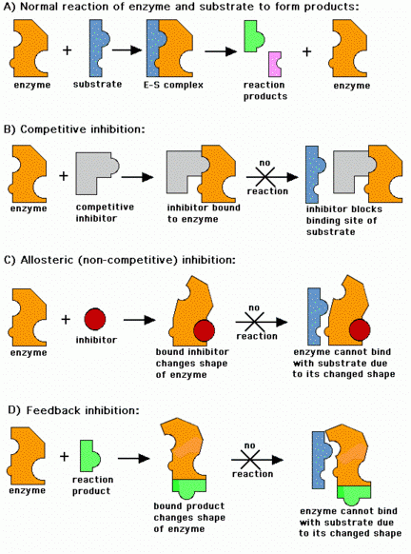

Slide 7
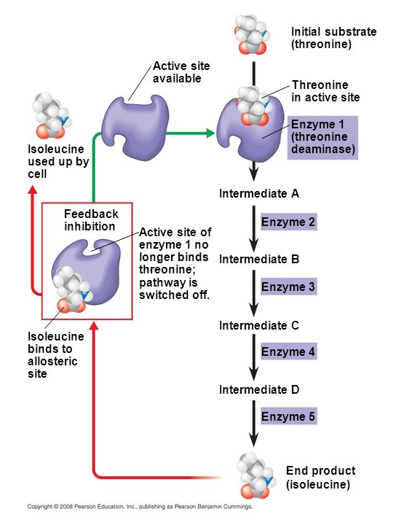
End product inhibition
When the end product is formed in excess, the excess products interact with enzymes at the beginning of the pathway → decrease enzyme activity
Negative feedback = the rate of the process decreases as the concentration of the product increases.
Example: Threonine to isoleucine (amino acids)
Notes:
Negative feedback: http://highered.mheducation.com/sites/9834092339/student_view0/chapter46/positive_and_negative_feedback.html

Slide 8
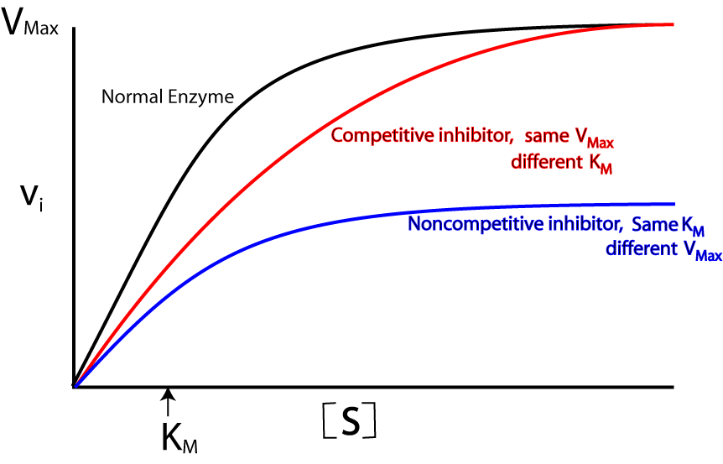
Distinguish between different types of inhibition
Competitive inhibition: more substrate, greater rate of reaction
Non competitive inhibition: prevents enzyme binding regardless of substrate concentration
V = rate of reaction
[S] = substrate concentration

Slide 9
